Slide 1




Factors Influencing Vaccination Coverage Rates
14 August 2022
Shreshta Phogat
Data 603 SU22
Notes:
I will be presenting the project entitled:

Slide 2


Shreshta Phogat
Data 603 SU22
Project Overview
Introduction
Background
Data set Description
Vaccination coverage rates by cohort
COVID-19 Vaccine hesitancy factors
14 August 2022
Notes:
To Start off a breif overview of the presentation I will go through the topic intro.....

Slide 3
Background
Vaccines aid in the prevention of Measles, Mumps, Rubella, and Polio, among many others
World Health Organization listed growing vaccine hesitancy as one of the top 10 threats to global public health.
Goal: to understand better the variables that impact vaccination rates in the United States
Notes:
The advent of vaccines has been instrumental in preventing deadly and debilitating disease and infection.
"Vaccines reduce risks of getting a disease by working with your body's natural defenses to build protection" (WHO, 2021).
For instance in children, vaccines have helped prevent diseases such as measles, mumps, rubella, and polio, among many others that previously caused death rates in the millions.
"However, there has been a recent rise in anti-vaccination sentiments surrounding beliefs that vaccines cause more harm than benefits to the health of thoes who receive them" (Hussain, 2018). For instance misinformation spread regarding Autism caused by the influenza vaccine.
In 2019 the World Health Organization listed growing vaccine hesitancy as one of the top 10 threats to global public health that needs to be addressed. "
This project's goal will be to understand better the variables that impact vaccination rates in the United States and find correlations between vaccination hesitancy and vaccination rates.

Slide 4

Background
Need
New pathogen
Zoonotic reservoirs
New generations
Since 1940, more than 300 new emerging infectious diseases have been identified (Gavi, 2020).
Notes:
Before getting into the data, I would like to quickly discuss the need for continued efforts in vaccination coverage and participation in vaccination programs.
people may say
Smallpox has been 'eradicated', polio is on its way out, and there is a decline in a wide range of other vaccine-preventable diseases like measles, diphtheria and pertussis. So is there a real need for continued vaccination efforts?
However, there are two key impacts here old pathogens re-emgering in new cohorts and new pathogens emerging.
It is important to note that there are, in fact only a handful of infectious diseases that can be eradicated; because while some diseases like polio exist exclusively in humans, others have natural reservoirs in animals, insects, or the environment. Continued vaccination of new generations becomes increasingly important.
Another key point here is that as we have seen in the most recent case of COVID-19 new pathogens and infectious diseases are emerging regularly since 1940 there have been more that 300 newly discovered infectious diseases.
A better understanding of the specific factors that influence vaccination coverage is essential to ensure proper information and resources to the right populations

Slide 5




Data Sources
ChildVaxView
TeenVaxView
AdultVaxView
CovidVaxView
Vaccination Coverage among Young Children (0-35 Months)
6.2MB, 67.1K Rows, 10 Columns
Vaccination Coverage among Adolescents (13-17 Years)
2.5MB, 23.3K Rows,
10 Columns
Vaccination Coverage among Adults (18+ Years)
4.1MB, 43.9K Rows, 10 Columns
National Immunization Survey Adult COVID Module (NIS-ACM)
599.2MB, 2.58M Rows, 13 Columns
National, regional, state, and selected local area vaccination coverage estimates for cohorts from the National Immunization Survey
Data Provided by:
National Center for Immunization and Respiratory Diseases (NCIRD)
Notes:
The data sets used for this project were retrieved from the National Immunization Survey (N.I.S.) implemented by the Centers for Disease Control and Prevention (C.D.C.), National Center for Immunization and Respiratory Diseases (NCIRD), and the National Center for Health Statistics (NCHS) branches.
First, to better understand Vaccine coverage rates for Vaccines included in the CDC's recommended Immunization Schedule, the Child, Teen, and Adult Vax View data sets were used.
As a second step to dive further into the data, the Covid vax view subset was used to look at factors influencing vaccine hesitancy and ultimately uptake, such as Age, Previous vaccination status (weather or not an individual had taken the flu vaccine before), and vaccination confidence status (meaning whether or not an individual believes a vaccine is safe.

Slide 6
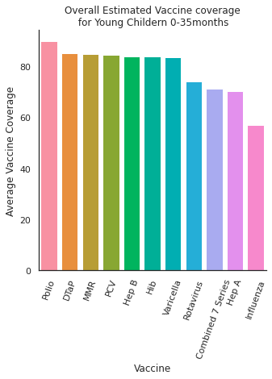
Child Vax View
Overall Vaccination coverage
The average sum of estimated vaccine coverage grouped by Vaccines recommended for children in this cohort
Notes:
First, looking at the Child Vax View data set we were able to determine

Slide 7
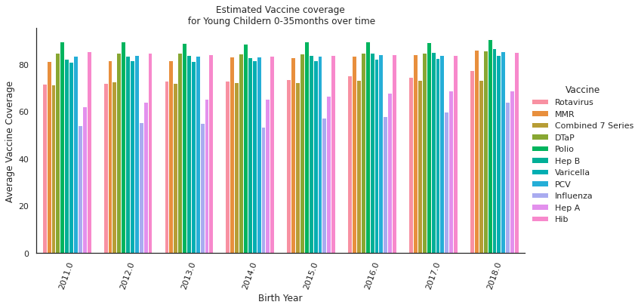
Child Vax View

Slide 8
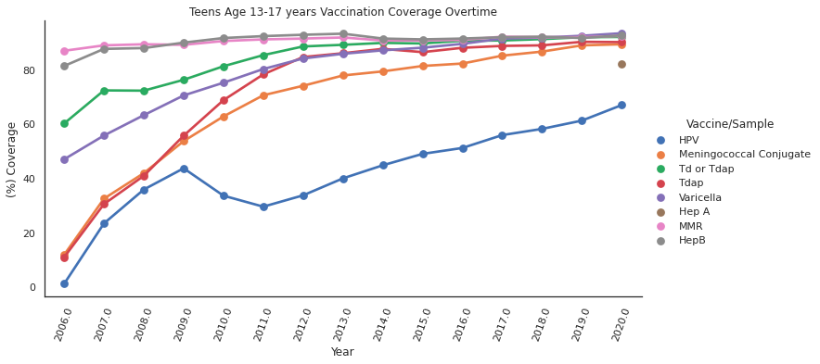
Teen Vax View
Overall Vaccination coverage
Notes:
The 2012 NIS-Teen asked parents who did not intend to vaccinate their daughters in the next 12 months (23% of respondents) the main reason why their daughters would remain unvaccinated. The top five responses were as follows: vaccine not needed (19.1%), vaccine not recommended (14.2%), vaccine safety concerns (13.1%), lack of knowledge about the vaccine or the disease (12.6%), and daughter is not sexually active (10.1%).

Slide 9
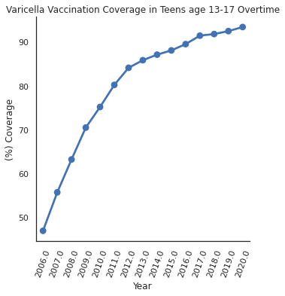
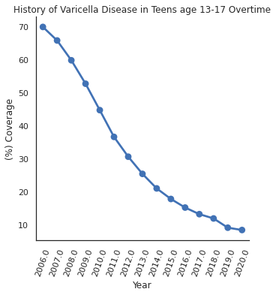
Teen Vax View

Slide 10
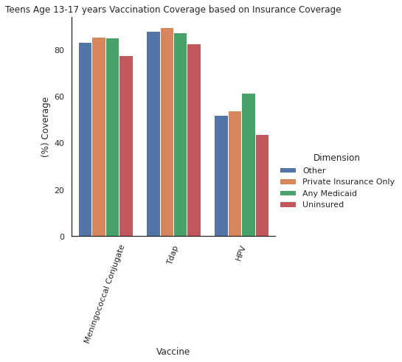
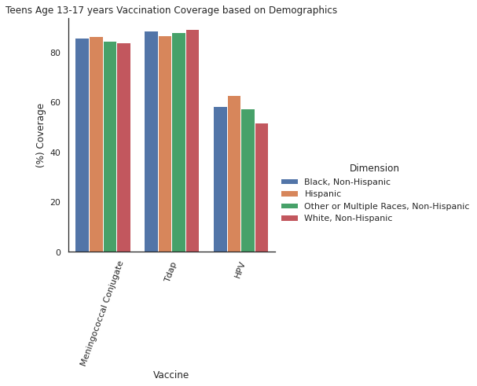
Teen Vax View

Slide 11
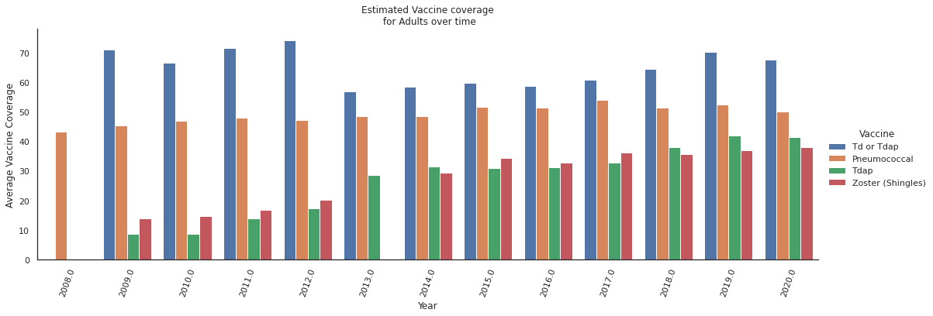
Adult Vax View
Overall Vaccination coverage

Slide 12
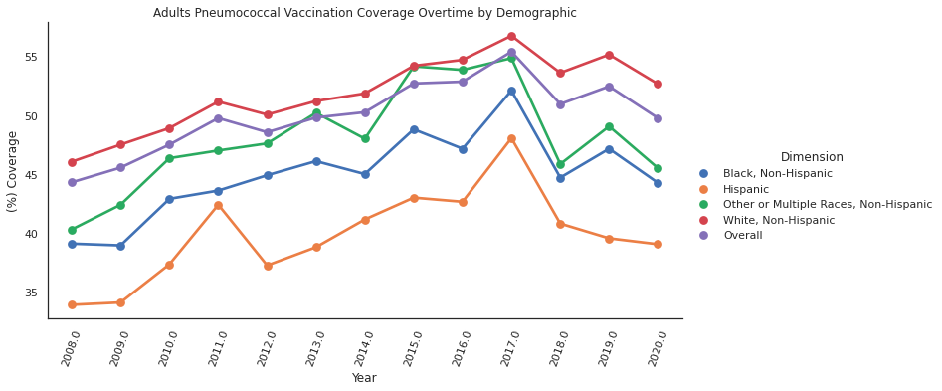
Adult Vax View

Slide 13
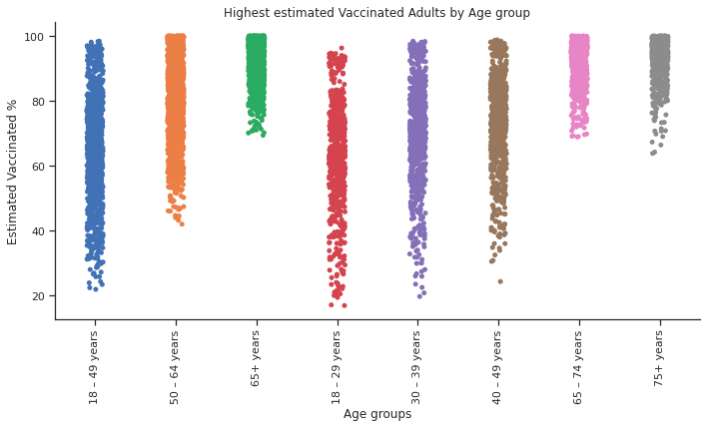
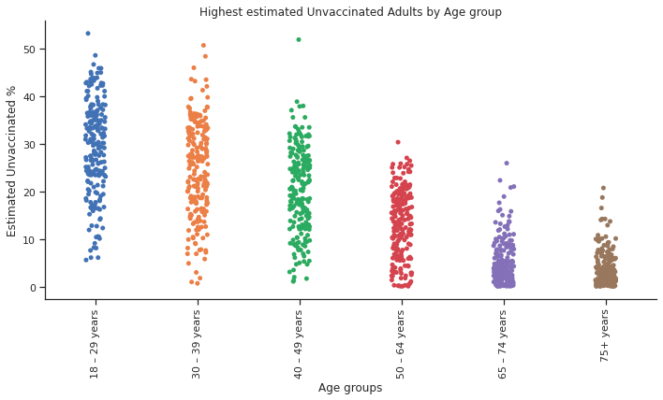
COVID Vax View
Estimated (%) vaccinated v.s. un-vaccinated divided by age group

Slide 14
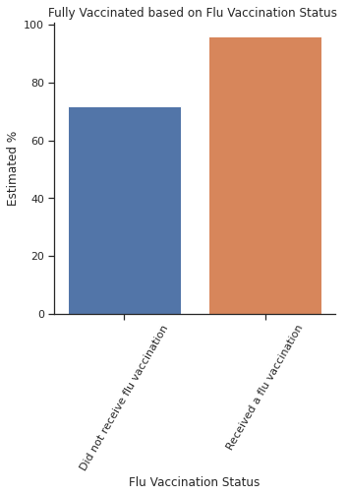
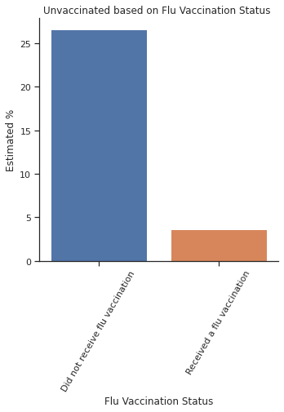
COVID Vax View
Estimated (%) vaccinated v.s. un-vaccinated sorted by previous flu Vaccination status

Slide 15
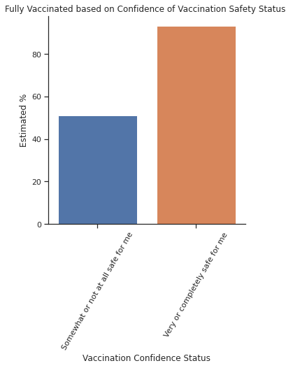
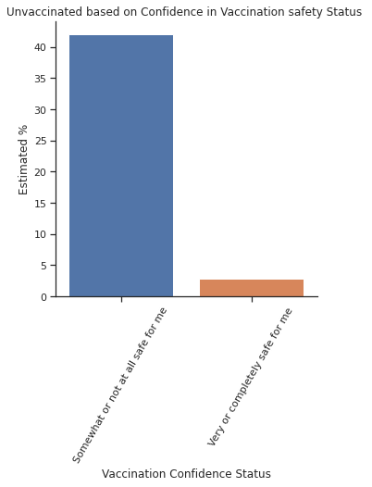
COVID Vax View
Estimated (%) vaccinated v.s. un-vaccinated divided by vaccine safety confidence

Slide 16
Summary
Children aged 0-36 months have steady rates possibly impacted by misinformation
Teens aged 13-17 show increasing vaccination rates over time
Vaccination rates and disease history are very strongly correlated
Impact of insurance status
Adults age 18+ lowest vaccination coverage
Vaccination likely hood can be linked with many factors some of which were looked at here
Notes:
Children aged 0-36 months have overall high vaccine coverage rates, and the trend seems to stay consistent over time however, misinformation regarding specific vaccines such as influenza causes consistently lowered vaccination rates
Teens aged 13-17 show increasing vaccination rates overtime excluding the case of HPV as discussed,
Vaccination rates and disease history are very strongly correlated, backing up the idea that continued vaccination for new cohorts is key
One of the factors that have an impact on vaccination coverage for teens is insurance status
Adults age 18+ tend to have the lowest vaccination coverage out of the three groups and trend in a slight increase or mostly similar vaccination coverage rate over time
Vaccination likely hood can be linked with age(depending on the vaccine), Previous vaccination status as well as vaccine safety confidence

Slide 17
Thank you!

Slide 18
References:
https://www.cdc.gov/nchs/nis/data_files_09_prior.htm
https://www.cdc.gov/vaccines/schedules/easy-to-read/child-easyread.html
https://www.chop.edu/centers-programs/vaccine-education-center/vaccine-history/developments-by-year
https://www.who.int/news-room/questions-and-answers/item/vaccines-and-immunization-what-is-vaccination
https://www.ncbi.nlm.nih.gov/pmc/articles/PMC6122668/
https://www.nytimes.com/2022/05/25/magazine/anti-vaccine-movement.html
https://www.who.int/news-room/spotlight/ten-threats-to-global-health-in-2019

